Slide 1
GROUP 15
Akrofi Nana Kwaku
Achaab Deborah
Ansah Emmanuel
Asare Sannaritta
Idrisu Gibril Issaka

Slide 2
PROBLEM
We all find it boring to be in a queue to be Identitied against our ID Card before entering a building. Wouldn’t It be nicer if our face is rather used as an identification process?

Slide 3
SOLUTION
Facial recognition is a biometric software application capable of identifying a person by comparing and analyzing patterns based on the person's facial contours. Facial recognition is mostly used for security purposes.

Slide 4
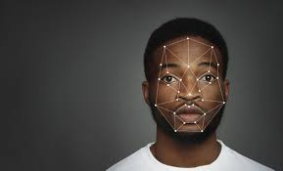
VISUAL

Slide 5
INNOVATION
As there are more solutions available on the internet on how to implement facial recognition program, we will source the best and efficient method to tackle this issue. We will also tap some of our solutions from the SRC TECHNOLOGY CHALLENGE

Slide 6
TECHNICAL
We will use a simple camera (like cctv camera) to detect face and compare it to some images in a database (this can be achieved using the program we will developed).

Slide 7
FEASIBILITY
We will be using minimal tools like a camera and a computer program to develop it. This makes our project affordable and implementable. It will also be viable since every building would like to have a facial recognition as a form of security measure.

